Slide 1
Basics of Physics
Physics is branch of science which deals with properties and interaction of matter and energy.

Slide 2
Branches
Mechanics
Branch of science which deals with motion under action of forces.
Science of machinery
Field theory
Provides knowledge about properties of fields such as
Gravitational fields, Electromagnetic field,

Slide 3
Divisions of Physics
Classical Physics
Mechanics
Dynamics
Optics
Heat
Electricity
Magnetism
Modern Physics
Nuclear physics
Molecular physics
Plasma physics
Atomic physics
Solid physics
Particle physics

Slide 4
Physical Quantity
Physical quantity is a property, body, or substance that can be qualified by measurement.

Slide 5
Physical quantities
Fundamental quantities
Derived quantities
Length
Mass
Time
Temperature
Amount of substance
Volume
Force
Pressure
Work
Power

Slide 6
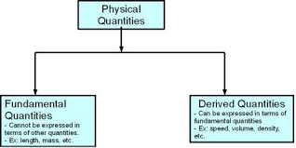

Slide 7
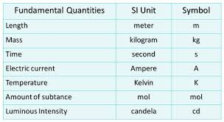

Slide 8
Work, Power, Energy
Work:
If a force is applied to a body and body moves in the direction of force, product is called work.
W = F X S
Force X Displacement of body in the direction of force
Unit : Joule
Amount of work done when force of one Newton displace a body through a distance of one meter.

Slide 9
Power
The rate at which work is done
Unit: Watt
When a force is applied to a body and displacement occurs at rate of one Joule per second, power is said to be one Watt.

Slide 10


Slide 11


Slide 12
Energy
The capacity of doing work
Unit: Kilowatt hour, joule
Types of Energy:
Kinetic
Potential
Heat magnetic
Hydropower
Chemical
Mechanical
Electrical
Nuclear

Slide 13
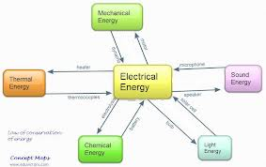

Slide 14
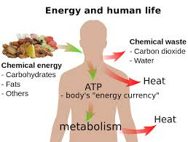

Slide 15
Conservation of Energy
Fundamental principle of Thermodynamics.
Energy is neither created nor destroyed
Total magnitude of a certain physical quantity of a system---mass or energy--- remains unchanged even though there may be exchange of that property between various components of that system.

Slide 16
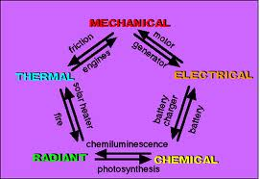

Slide 17
Energy Source
Renewable
Non-renewable
Which will replenish themselves naturally in a relatively shorter time and will therefore always be available.
Solar
Tidal
wind
Which cannot be used again and again
Fossil fuels
Coal
Petroleum
Natural gas

Slide 18
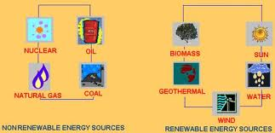

Slide 19
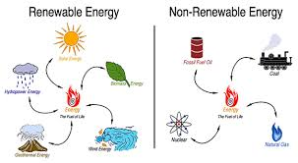

Slide 20
Nuclear Energy
The most powerful energy in the Universe
Two ways of producing nuclear energy
Splitting nucleus of an atom
Joining or fusing nuclei of two atoms

Slide 21
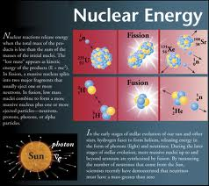

Slide 22
Nuclear Fission
Method of production of nuclear energy
Bombardment of nucleus with other particles
Chain reaction
Uranium +neutron ---- Krypton+Barium+2N+ E

Slide 23
Nuclear reactor/ Plant
Device in which fission reaction is controlled for feat production
Heat---steam---Turbine---Electricity
Major parts:
Fuel; natural Uranium slightly ( 3/) to highly enriched
Moderator: to slow down neutrons
Coolant: to extract fission heat for useful purposes

Slide 24
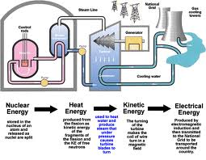

Slide 25
Nuclear Fusion
Other way of getting nuclear energy
Joining together of atoms
Require high temperature
Taking place in stars

Slide 26
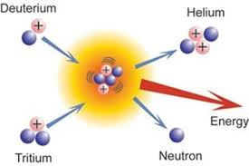

Slide 27
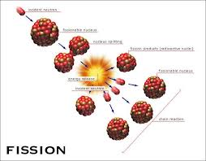

Slide 28
